Slide 1




Balancing Performance and Resource-Awareness: Optimizing the Model Selection and Ensemble Process in Machine Learning
Master‘s Theses Update
by Niklas Diller (Computing in the Humanities) on 29.11.2023

Slide 2
Outline
Motivation
Related Work
Approach
Research Question, Hypotheses and Title
Project Plan

Slide 3
Recap
How to optimize Model Set Retrieval process?
Ensembles as output to increase overall performance ➔ Implementation of Model Ensembles
Using weights to make more precise calculations for Alignment-Levels ➔ Definition of new Level System
Show only models trained on same farms, sensor systems,… ➔ Adding filters to improve UX
Notes:
1. Until now: Look at output of the different models in a model set and consider, which prediction seems the most likely one -> Highly error prone/not precise/possibly many contradictions between single models
-> Introduce Model Ensembles that give one prediction on the basis of multiple models in the Ensemble (Many different methods for ensembles, will have to settle on one for implementation) Most focus in theses will probably be here.
2. Until now: Levels pretty static: A level is either reached or not reached -> Unfair comparison/actual differences in one level are too big.
-> Work with sub-levels (finer subdivision of levels, but maybe short-sighted) or work with weights: How much % of a level is reached, how much will one level influence the other upcoming levels?
3. Until now: User can only input treshold/contraint -> Might want to specifically search for models that fulfil certain criteria
-> Filter for models that were trained on same farms/cows/sensor systems. Mayabe even filter for certain model algos, but probably not necessary
Evaluation: Accuracy, root-mean-squared error, latency, memory footprint

Slide 4
Recap
How to optimize Model Set Retrieval process?
Ensembles as output to increase overall performance ➔ Implementation of Model Ensembles
Using weights to make more precise calculations for Alignment-Levels ➔ Definition of new Level System
Show only models trained on same farms, sensor systems,… ➔ Adding filters to improve UX
Notes:
1. Until now: Look at output of the different models in a model set and consider, which prediction seems the most likely one -> Highly error prone/not precise/possibly many contradictions between single models
-> Introduce Model Ensembles that give one prediction on the basis of multiple models in the Ensemble (Many different methods for ensembles, will have to settle on one for implementation) Most focus in theses will probably be here.
2. Until now: Levels pretty static: A level is either reached or not reached -> Unfair comparison/actual differences in one level are too big.
-> Work with sub-levels (finer subdivision of levels, but maybe short-sighted) or work with weights: How much % of a level is reached, how much will one level influence the other upcoming levels?
3. Until now: User can only input treshold/contraint -> Might want to specifically search for models that fulfil certain criteria
-> Filter for models that were trained on same farms/cows/sensor systems. Mayabe even filter for certain model algos, but probably not necessary
Evaluation: Accuracy, root-mean-squared error, latency, memory footprint

Slide 5
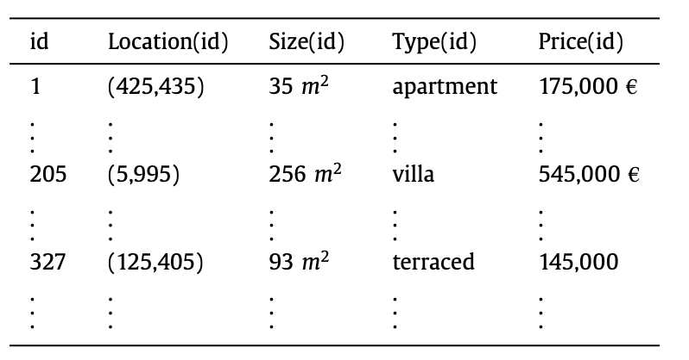
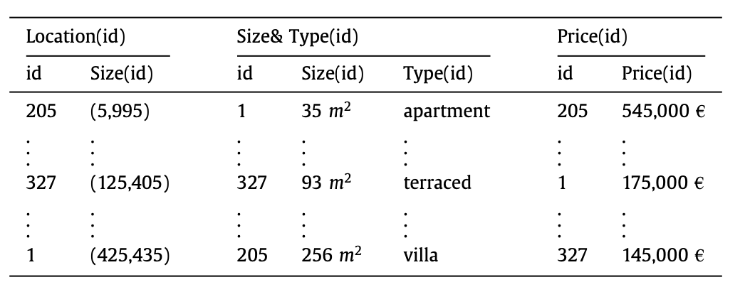
Top K Retrieval
Each data entry has different scores, one for each quantitative attribute
Combine individual scores according to an overall score function to gain overall score for each data entry
Sort all possible data entries according to overall score and display the best K results based on this score
Getting answer is straightforward, critical part is execution time and cost
Notes:
In my case attriburtes would e.g. be accuracy and query sharing level. Using the assigned weight (by user) the overall score is then computed

Slide 6
Naïve Algorithm
Sort entries by individual score
Accessing every individual score and combine them to get overall score of each entry
Sorting the data entries according to their overall score
Returning the Top K of this sorted list
➔ Straightforward but extremely expensive

Slide 7
Fagin’s Algorithm
Sort entries by individual score
Access entries in sorted list in parallel until every attribute of k entries has been seen / k entries are “complete”
Random access to obtain missing values of seen items
Compute overall score using score function, sort and return the Top K
➔ Good if ranking function is strict & if K is not too high
Notes:
Strict = best possible score when each attribute is maxmimum
Good, if K is not high

Slide 8
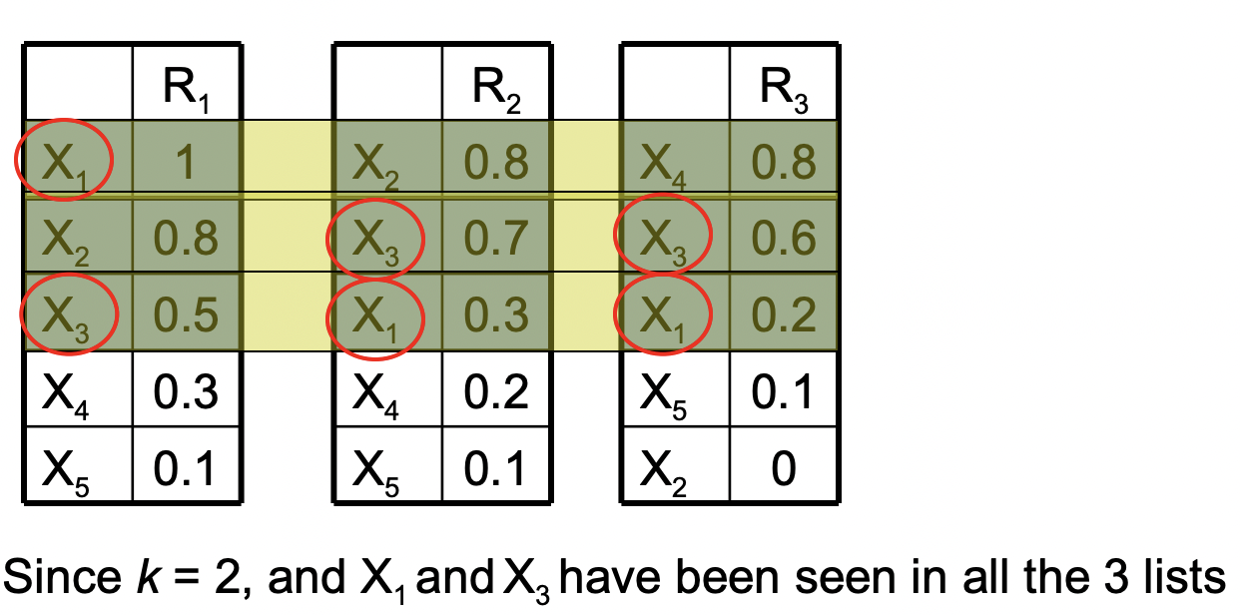
Fagin’s Algorithm
Source: http://alumni.cs.ucr.edu/~skulhari/Top-k-Query.pdf
Notes:
Strict = best possible score when each attribute is maximum
Good, if K is not high

Slide 9
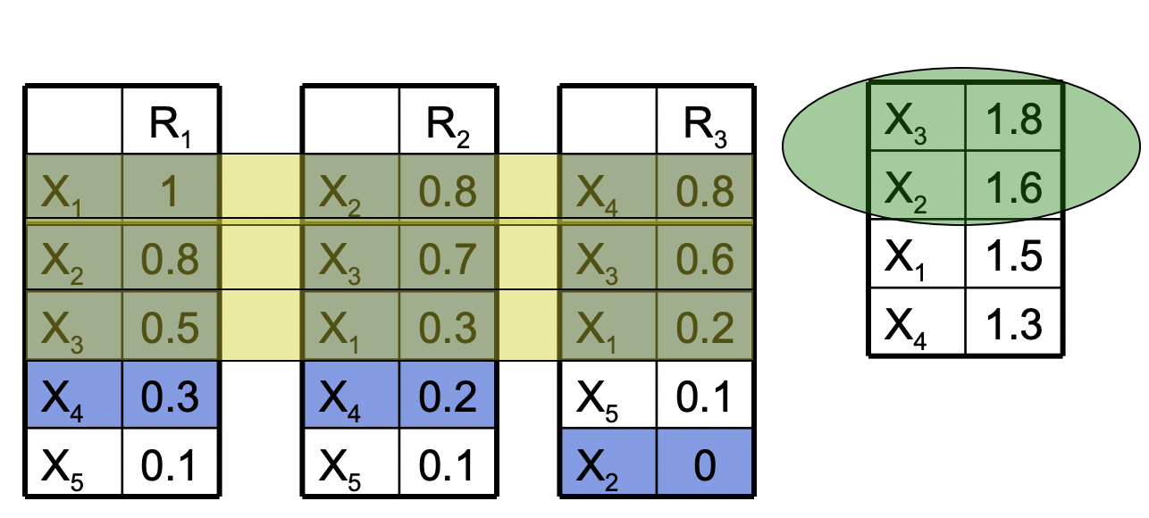
Fagin’s Algorithm
Source: http://alumni.cs.ucr.edu/~skulhari/Top-k-Query.pdf
Notes:
Strict = best possible score when each attribute is maxmimum
Good, if K is not high

Slide 10
Threshold Algorithm
Sort entries by individual score
Access entries in sorted list in parallel and generate threshold based on this row
Random access to find all scores of seen objects and compute their overall score
Keep track of the Top K entries seen so far
When scores of Top K entries are larger than threshold, stop and return Top K
➔ Optimal in a stronger sense and requires smaller buffer
Notes:
Only one example of a Treshold Algo -> Many different ones available, e.g. Clockwise Algo

Slide 11
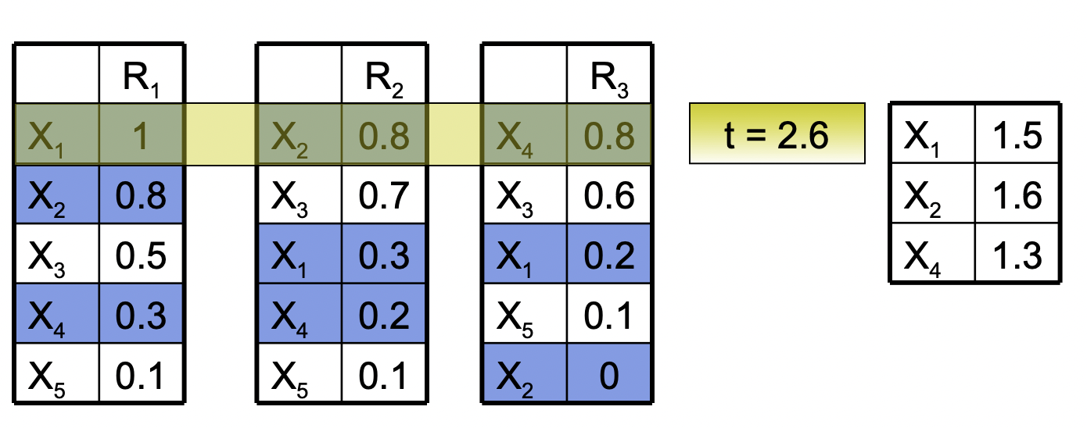
Threshold Algorithm
Source: http://alumni.cs.ucr.edu/~skulhari/Top-k-Query.pdf
Notes:
Only one example of a Treshold Algo -> Many different ones available, e.g. Clockwise Algo

Slide 12
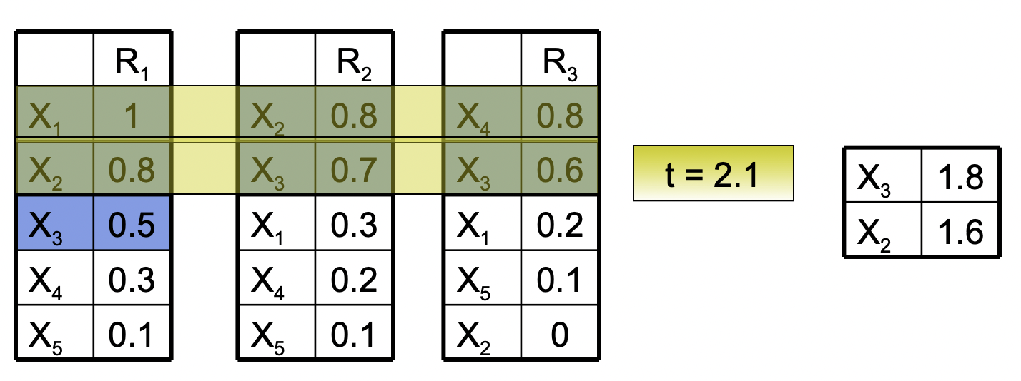
Threshold Algorithm
Source: http://alumni.cs.ucr.edu/~skulhari/Top-k-Query.pdf
Notes:
Only one example of a Treshold Algo -> Many different ones available, e.g. Clockwise Algo

Slide 13
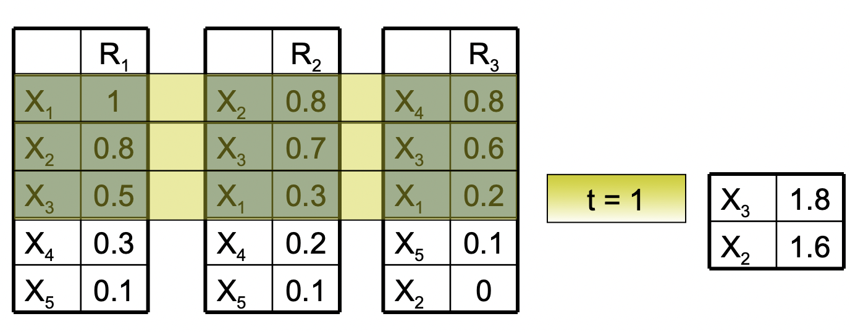
Threshold Algorithm
Source: http://alumni.cs.ucr.edu/~skulhari/Top-k-Query.pdf
Notes:
Only one example of a Treshold Algo -> Many different ones available, e.g. Clockwise Algo

Slide 14
Parameters to adjust
K
How many results do I want to get?
Ranking Function
What results do I want to get?
Thresholds
What results do I want to exclude? (e.g. only above 75% accuracy,…)
Other filters
Am I interested in only a specific type of training subset/ML algorithm?
Efficiency Methods

Slide 15
Efficiency Methods
E.g. Searching for maximum in each basic function
Measuring the distance between the maximum and the given function
Different efficiency methods for different ranking functions
(monotonic vs. non-monotonic, etc.)
➔ Considering as few tuples as possible should be general aim

Slide 16
References
[1] R. Fagin, ‘Combining fuzzy information: an overview’, SIGMOD Rec., vol. 31, no. 2, pp. 109–118, Jun. 2002, doi: 10.1145/565117.565143.
[2] N. Madrid and P. Rusnok, ‘A Top-K Retrieval algorithm based on a decomposition of ranking functions’, Information Sciences, vol. 474, pp. 136–153, Feb. 2019, doi: 10.1016/j.ins.2018.09.014.
[3] I. F. Ilyas, G. Beskales, and M. A. Soliman, ‘A survey of top- k query processing techniques in relational database systems’, ACM Comput. Surv., vol. 40, no. 4, pp. 1–58, Oct. 2008, doi: 10.1145/1391729.1391730.
[4] S. Kulhari, ‘Combining Fuzzy Information - Top-k Query Algorithms’. Accessed: Nov. 22, 2023. [Online]. Available: http://alumni.cs.ucr.edu/~skulhari/Top-k-Query.pdf

Slide 17
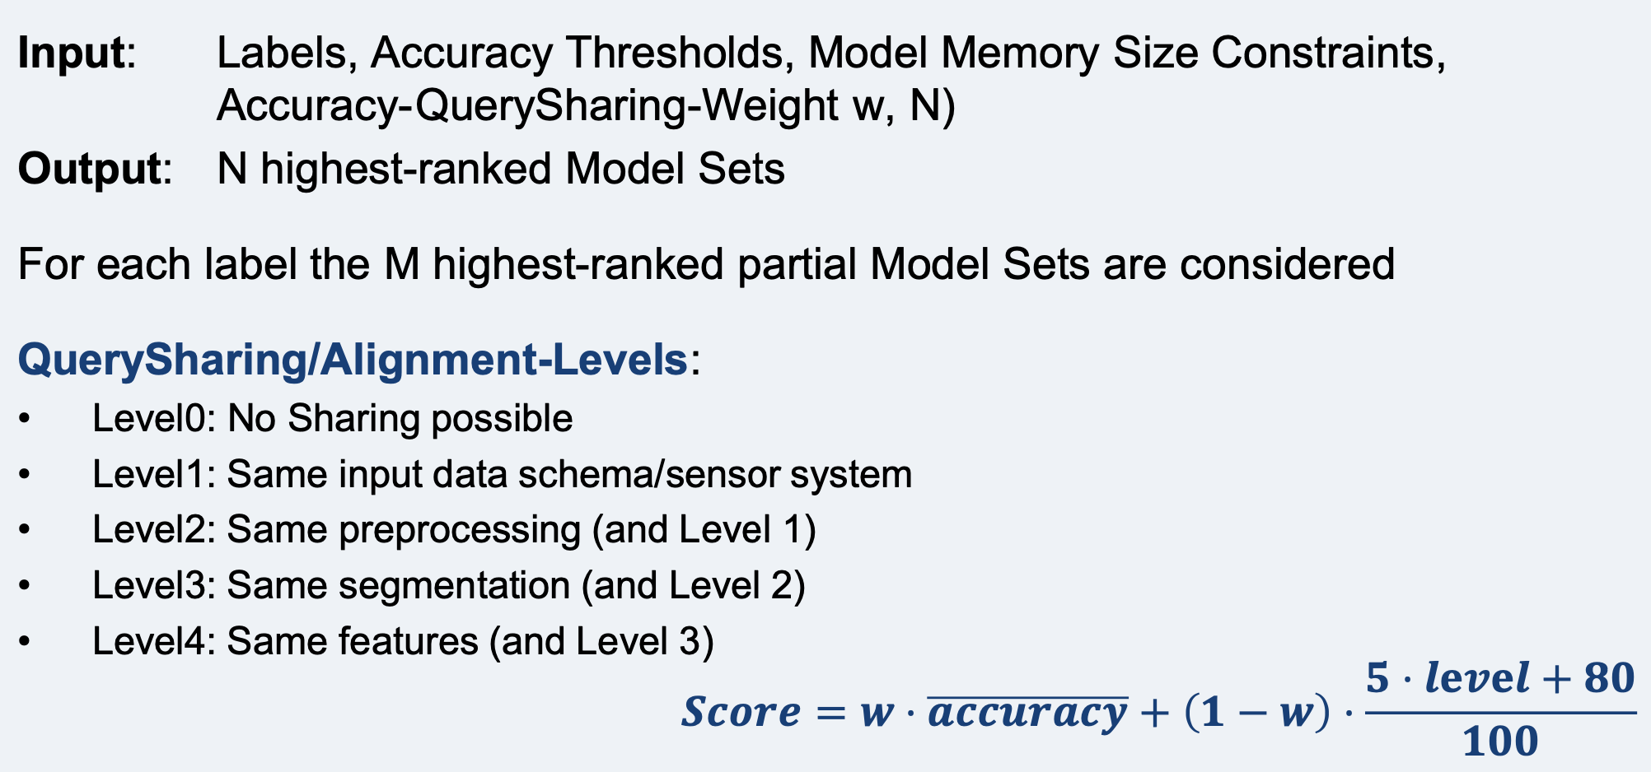
Current approach lacks performance but has potential
Notes:
Screenshot of PerCom slides
Decription of Model Set Minder
Has potential for improvisation
1. Until now: Look at output of the different models in a model set and consider, which prediction seems the most likely one -> Highly error prone/not precise/possibly many contradictions between single models
2. Until now: Levels pretty static: A level is either reached or not reached -> Unfair comparison/actual differences in one level are too big.
3. Until now: User can only input treshold/contraint -> Might want to specifically search for models that fulfil certain criteria

Slide 18
Research Question and Hypothesis Proposals
How Does Optimizing the Selection and Ensembling Process for Machine Learning Models Support the Resource-Awareness of Machine-Learning-Based Data Stream Processing?
Creating Ensembles Out of a Model Registry Instead of Looking at a Model Set Consisting of Multiple Single Models Increases the Performance of the Classifying Process.
Constructing a Level- and Weight-Based System for Determining the Similarities Between Models Improves the Resource Awareness of the Classifier.
Adding Filters In the Model Retrieval System Helps To Save Resources Without Decreasing the Accuracy of the Classifier.
Notes:
Derived different hypotheses from the approach that can be summarized under one big research question
Especially third hypothesis hard to prove

Slide 19
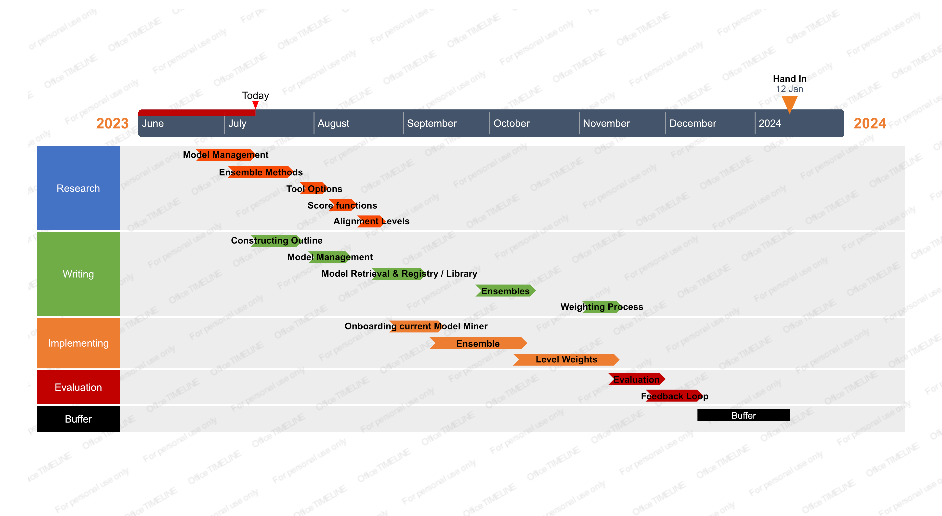
Project Plan

